Slide 1


Automated recognition of geographical named entities in titles of Ukiyo-e prints
MARITA CHATZIPANAGIOTOU, Athens University of Economics And Business
EWA MACHOTKA, Stockholm University
JOHN PAVLOPOULOS, Stockholm University
A Study of Distant Viewing of Ukiyo-e Prints
KONSTANTINA LIAGKOU, Athens University of Economics And Business
JOHN PAVLOPOULOS, Stockholm University
EWA MACHOTKA, Stockholm University

Slide 2

CONTENT
01
Introduction
THE RATIONALE OF THIS PROJECT
Corpus
UKIYO-E LANDSCAPE PRINTS
02
03
Methodology
METHODS AND DATASET
Empirical results
EVALUATION METRICS FOR NER
04
05
Conclusions
CASE-STUDY, LIMITATIONS, FUTURE WORK
Notes:
This paper investigates the application of Natural Language Processing as a means to study the relationship between topography and its visual renderings in early modern Japanese landscape prints. In the following slides, first, we explain the rational of this project. Then, we introduce our corpus i.e. landscape prints with inscriptions that have been annotated by an art historian for any included place-names. We describe our methodology: our method and dataset. And we present our experiments with the use of NER. LAstly, we will close with a mention for a case study, limitations and future work

Slide 3

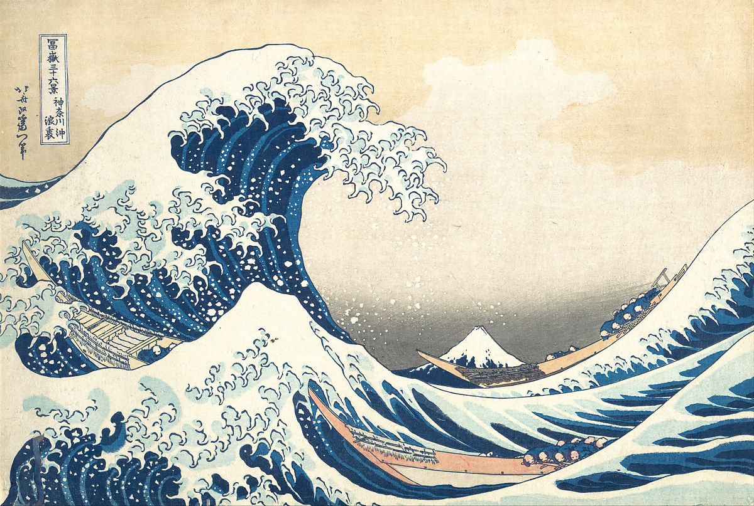
The rationale of this research project
Katsushika Hokusai (1760-1849)
神奈川沖浪裏​​
“Under the Wave off Kanagawa”
from the series 富嶽三十六景 “Thirty-six Views of Mount Fuji” ca. 1830–32, MET.
Place-name entity
Notes:
First let me explain the rationale for this research project.Japanese early modern woodblock prints, so-called ukiyo-e or ‘pictures of the floating world’ produced between the seventeenth and mid-nineteenth century, are one of the most widely recognizable visual images today. Among diverse topics depicted in these images, landscape prints remain the most popular as evidenced by the iconic “The Great Wave” designed by Katsushika Hokusai in the 1830s and its global career. However, the understanding of prints is still shaped by Western modern epistemologies that may not be well fitted for the analysis of pre-modern non-Western artefacts. For example, the genre of ‘landscape' is a Western modern art category linked to the function of images as representations of certain places and topography. But this category is applied to the pre-modern objects such as this Hokusai’s print created in the1830s only after Japan started its modernization process in 1868. Therefore, to understand social function of premodern prints there is a need to approach them from a different perspective that take as an analytical point of departure the objects themselves: their content, formal characteristics, their historical context. The question is however how to do it considering that corpora are extremely rich and diversified. Traditional analytical methods based on close reading or interpretation of individual images are not effective for this task. Therefore, we have decided to explore a possibility to complement close reading with macroanalysis of large dataset of prints with help of computational tools to group the images on the basis of their visual features (content-based and formal characteristics) and develop a new classification of prints that we today perceive as ‘landscapes’. This is of course a very complex task and today we are presenting the results of the first phase of the study.
Click: To develop a new classification of Japanese prints, this project approached the task by employing Named Entity Recognition (NER), an NLP technique used to detect named entities in texts. In principle, NER can be used to extract named locations from any text, including ones mentioned in the titles of Japanese prints. Any extracted locations, then, may allow for a digital geospatial exploration of the studied prints, which can shed light regarding the geographical distribution of the sites depicted within the prints as well as regarding the frequency of the depiction of certain sites in relation to their production context (e.g. time, location and designer). Hence, our initial premise was that the combination of ‘distant viewing’ or macroanalysis of visual materials, and ‘close reading’ of the artefacts has a potential to develop a more nuanced understanding of prints.

Slide 4
Research Questions
What kind of places are depicted in meisho-e prints and what places are not featured in the images?
How are these places distributed across Japanese territory?
NLP technology allows for a large-scale digital geospatial exploration of the studied prints.
Notes:
The goal of this study is is to answer the following research questions:
Firstly, What kind of places are depicted in meisho-e prints and what places are not featured in the images?
Second, How are these places distributed across Japanese territory?
To achieve answer to this question, we used Natural Language Preprocessing methods that allows us to explore a large-scale digital geospatial of the studied prints

Slide 5
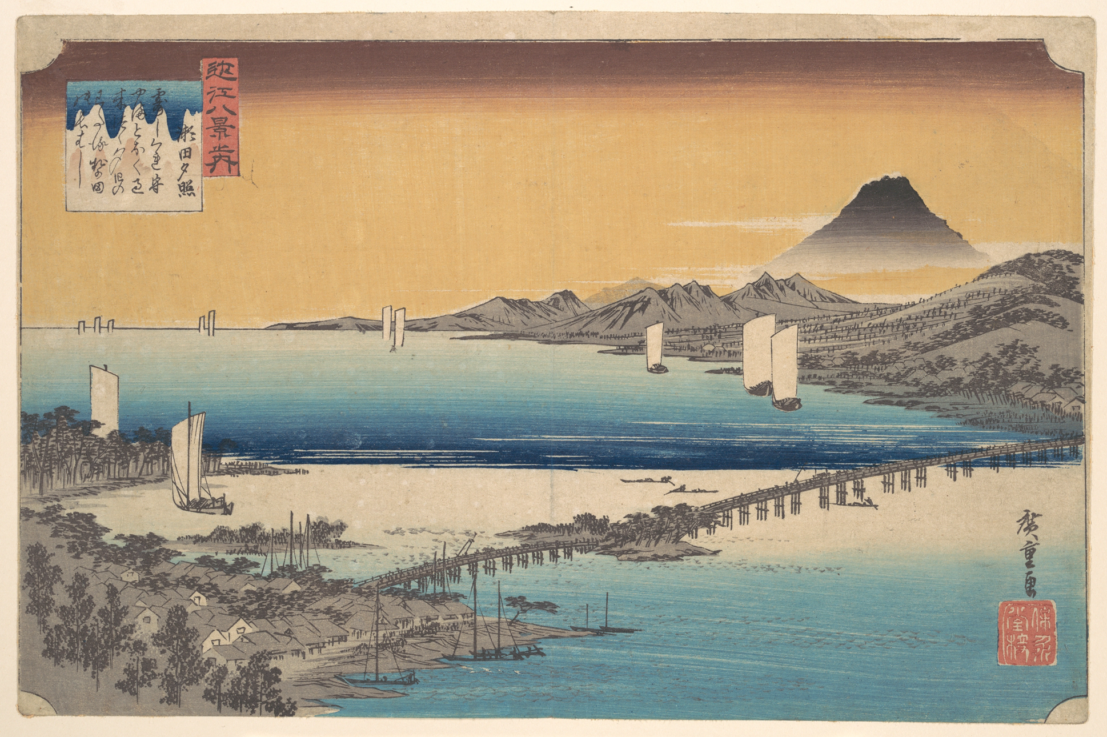
Ukiyo-e landscape prints
Utagawa Hiroshige (1797-1858), 瀬田夕照 (Sunset Glow at Seta), from the print series 近江八景之内 (The Eight Views of Ōmi, 1834-35), 23.3 cm x 35.5 cm, multicolour woodblock print, the Metropolitan Museum of Art, New York (OA).
Notes:
The nineteenth century Japan saw the raise in popularity of prints depicting countryside. But despite their seemingly straightforward subject i.e. landscape, the social function of these images is little understood as it is rooted in a different episteme. These images were in fact defined as meisho-e (pictures of famous places). The topography was not necessarily relevant, as the concept of meisho derives from poetic rhetorical figures that tie seasonal images with particular places. For example, let’s focus on this print by Utagawa Hiroshige from the woodblock print series “The Eight Views of Ōmi”.

Slide 6
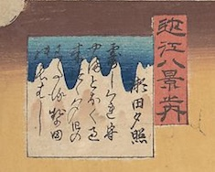
Ukiyo-e landscape prints
Two cartouches in the upper left corner:
red cartouche with the title of the print series 近江八景 Ōmi hakkei (The Eight Views of Ōmi)
square cartouche with the name of the place 瀬田夕照 Seta no sekishō (Sunset Glow at Seta River), and a poem related to this place:
つゆ時雨もる山遠く過き來つゝ夕日のわたる勢多の長はし
‘The long bridge at Seta, over which crosses the setting sun, passing far beyond the mountains, dripping with autumn dew’
Utagawa Hiroshige (1797-1858), 瀬田夕照 (Sunset Glow at Seta), from the print series 近江八景之内 (The Eight Views of Ōmi, 1834-35), 23.3 cm x 35.5 cm, multicolour woodblock print, the Metropolitan Museum of Art, New York (OA).
Notes:
The inscription in the square cartouche in the upper left corner features the poem: “The long bridge at Seta, over which crosses the setting sun, passing far beyond the mountains, dripping with autumn dew”.
The image presents a view of the famous Seta Bridge in the southeast part of Lake Biwa with Mt. Mikami in the background. Although Mt. Mikami is not very high at only 432 m., its form has been modified to liken it to Mt. Fuji, which is 3776 m high. But the image curates reality on at least one more level. Despite being produced at the peak of the famine it shows an idyllic view of the countryside. Therefore, interpretation of these images requires understanding how they refer, depict and distort topography: what places are depicted and what places are not featured in the images; how are these places distributed across Japan and in relation to socio-cultural, political and economic contexts; and how their distribution changes in time and depending on the designer, publisher, format etc. Considering the scope of the data and the nature of the inquiry computational methods offer a potential to assist art historical studies.

Slide 7
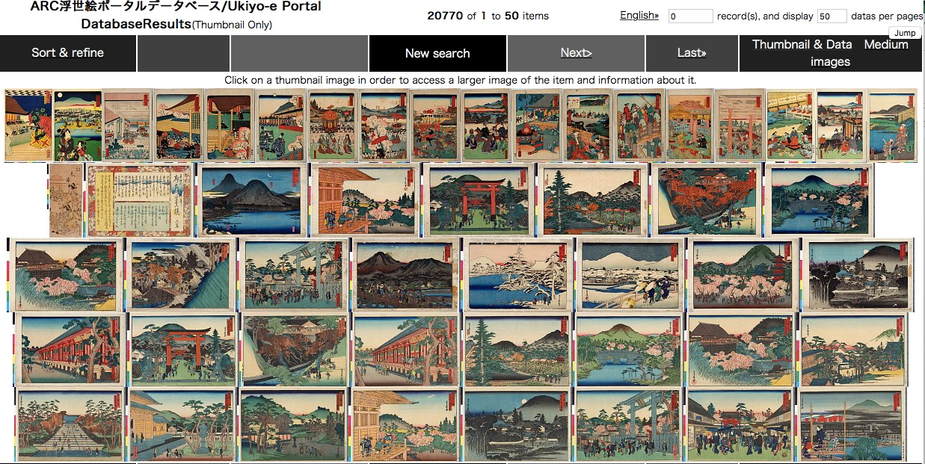
Dataset development
Ukiyo-e Portal Database, Art Research Center, Ritsumeikan University, Kyoto (screenshot)
Notes:
To conduct ‘distance viewing’ of images we of course needed data. Fortunately, the access to the data for this work was facilitated by the database hosted at the Art Research Centre at Ritsumeikan University, one of the leading Digital Humanities hubs in Japan and a collaborative partner of this project. The centre’s digital databases of Japanese printed culture hosts approx. 700,000 (678,429) prints kept at 28 institutions in Japan and abroad. Our study investigated approx. 20,000 (20,408) digitized prints featuring natural environments, issued around 1800-1850s.

Slide 8

Dataset development
Over 20,408
200
469
Ukiyo-e prints
Annotated by an art historian,
expert in Japanese early modern history.
Place names in the titles
Notes:
From the around 20,000 digitized prints which arose from our search based on the keyword ‘meisho’ (famous place) and ‘meisho-e’ (image of a famous place), we randomly selected 200 samples to annotate and use them to train and test machine learning algorithms regarding extracting place-name entities. An art historian, an expert in Japanese early modern history annotated two sets of images (100 images each) identified through random sampling and after annotation appears 469 place names tags

Slide 9
Dataset development
Inter-annotator Agreement (ΙΑΑ)
Micro-averaged Cohen’s kappa
Tags for place-names
Annotations
1
LOC (Location)
Places that were less-easily pinned on a map (e.g. roads, mountain ranges)
42.97%
104
.
78.63%
2
GPE (Geopolitical)
Places that were possible to be pinned on a map (e.g. names of cities, temples, shrines, bridges)
365
78.80%
3
PLACE
All places, merge LOC and GPE
469
Number of tags
Notes:
The annotation process was guided by two major principles.
click:First, all places that were possible to be pinned on a map (e.g. names of cities, temples, shrines, bridges) were annotated as GPE and we detect 365 GPE tag.
click: Second, places that were less-easily pinned on a map (e.g. roads, mountain ranges) were annotated as LOC with 104 tags.
click: A second annotator annotated the inscriptions of 20 randomly prints of the already annotated sample to perform inter-annotator agreement.
After calculating the micro-averaged cohen;s kappa, we found that two annotators agreed by 42% for LOC
click: and agreed much more on GPE, with around 78.6% cohen kappa. As we can see here, to annotate the scriptions with GPE and LOC tags was very difficult for the japanese expert, let alone for a machine learning model that can learn only the annotation for an expert.
click: Thus, we decide to merge the GPE and LOC to a single tag, with name, PLACE. This, increase the results of inter-annotator agreement to 78.8%

Slide 10
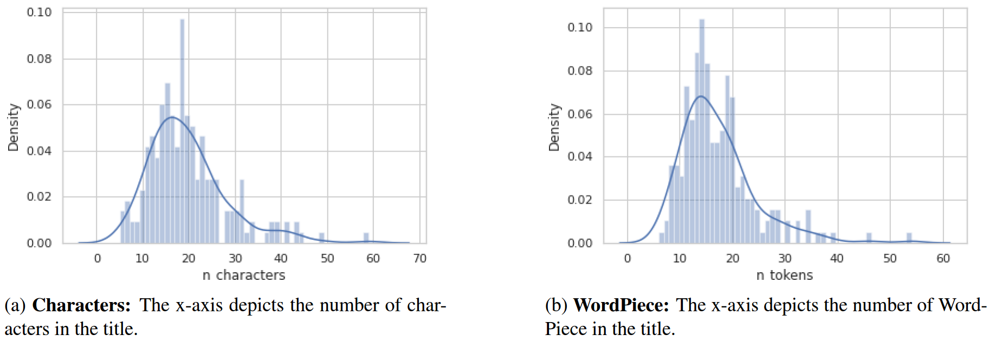
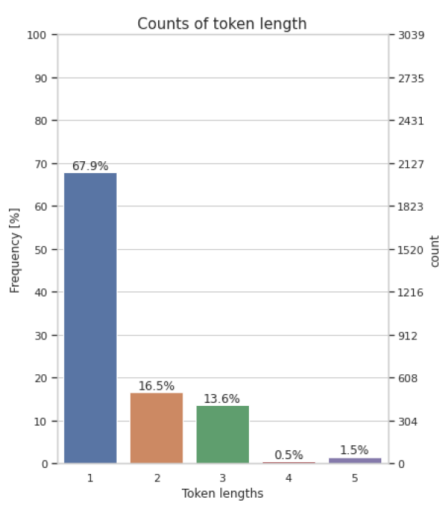
Dataset development
 | Avg | Min | Max
tags per title | 2.33 | 1 | 11
characters per GPE tag | 2.62 | 1 | 8
characters per LOC tag | 2.93 | 2 | 5
cartouches per title | 2.50 | 1 | 11
character tokens per title | 19.68 | 5 | 59
WordPiece tokens per title | 17.17 | 6 | 54
length per token | 1.52 | 1 | 5
Table: Ukiyo-e prints statistics that count of a number of dimensions
Notes:
click: Here, there are some statistics for ukiyo-e prints that count the average ,minimum and maximum of tags and tokens. For instance, around 17 tokens appear in each title, after using WordPiece tokinizer.
The image content-related inscriptions have 19.68 Sino-Japanese kanji characters on average, with minimum 5 and maximum 59.
click: Then to have a more complete picture around the data, we did deeply exploratory analysis in the tokens and the characters. As, seen in barplot, the tokens had length from 5 characters to 1 characters, which were the most.
click: The length of the titles, counting in word pieces, follows the normal distribution without a lot of outliers as can be seen in distribution plot with the mean is 17 tokens as we said before.

Slide 11
Methodology
NER to identify place-names (LOC & GPE) in inscriptions on ukiyo-e
Used 100 to evaluate the NER models
Precision Recall F1-Score
Computed Cohen kappa for inter-annotator agreement
1
3
5
2
4
6
Used 100 to fine-tune pre-trained spaCy and Bert models
Reannotate 20 by a second annotator, an expert in Japanese history and language
Retrain the best BERT models with concat place-name (PLACE)
Notes:
Click: Our methodology based on Name Entity Recognizer to identify the place-names in inscriptions on ukiyo-e.To develop a model, we need a annotated dataset, so our main art historian, Ewa, create LOC and GPE tags
for the place-name entities for 200 inscriptions.
Click: Then, we fine tune pretrain spacy and bert models with the half data,
Click: and evaluate them with the other half. As we have an entity classification model , we select to use the most widely metrics, precision, recall and f1-score.
Click: Then, a second annotator annotated the inscriptions of 20 randomly prints of the already annotated sample to perform inter-annotator agreement.
Click: To calculate the inter-annotator agreement, we used the Cohen kappa score
Click: Last but not least, we retrain our the best model, BERT, with a single tag PLACE. PLACE is merge tag of GPE and LOC tags

Slide 12
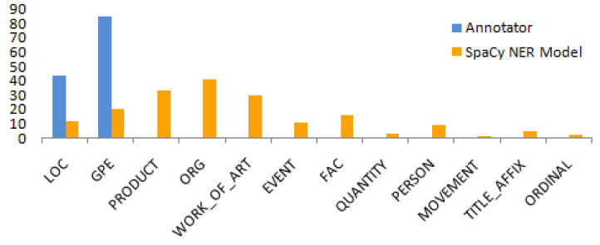
SPACY

Slide 13
Evaluation metrics
 | Precision | Recall | F1-score
 | SPACY | SPACY | SPACY
GPE | 0.84 | 0.08 | 0.15
LOC | 0.53 | 0.14 | 0.23
Table: Evaluation of SpaCy ‘default’ and ‘calibrated’ with Precision, Recall and F1-score at the named entity level, on 100 instances. In bold is the best scores.

Slide 14
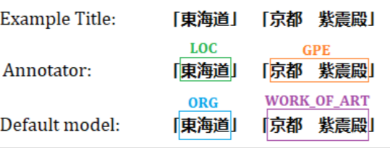
Evaluation metrics
 | Precision | Recall | F1-score
 | SPACY | SPACY | SPACY
GPE | 0.84 0.39 | 0.08 0.44 | 0.15 0.41
LOC | 0.53 0.59 | 0.14 0.50 | 0.23 0.54
Table: Evaluation of SpaCy ‘default’ and ‘calibrated’ with Precision, Recall and F1-score at the named entity level, on 100 instances. In bold is the best scores.
Fine-tuning SPACY achieve
far better F1-score

Slide 15
Evaluation metrics
 | Precision | Recall | F1-score
 | SPACY BERT | SPACY BERT | SPACY BERT
GPE | 0.39 0.73 | 0.44 0.74 | 0.41 0.74
LOC | 0.59 0.59 | 0.50 0.50 | 0.54 0.54
Table: Evaluation of SpaCy and BERT NER with Precision, Recall and F1-score at the named entity level, on 100 instances. In bold is the best F1-scores.
Fine-tuning BERT with PLACE labels F1-score increases to 78%
Notes:
For geopolitical entities, however, BERT outperformed Spacy, achieving a balanced performance between Precision and Recall, and a 74% F1-score. Spacy, on the other hand, had a high Precision but very low Recall, leading to an F1-score of 41%.
Error analysis revealed that the entities were detected in the text, but their tag was often misclassified, which might be explained by the very low agreement for the location tag. But the agreement increased when we merged the tags. Doing the same for the computational experiments, merging the two labels into a single PLACE entity tag, and re-training our best performing BERT, showed that the F1 score increased by four units.
Thus, we Fine-tune the BERT with PLACE labels and F1-score increases to 78%.

Slide 16
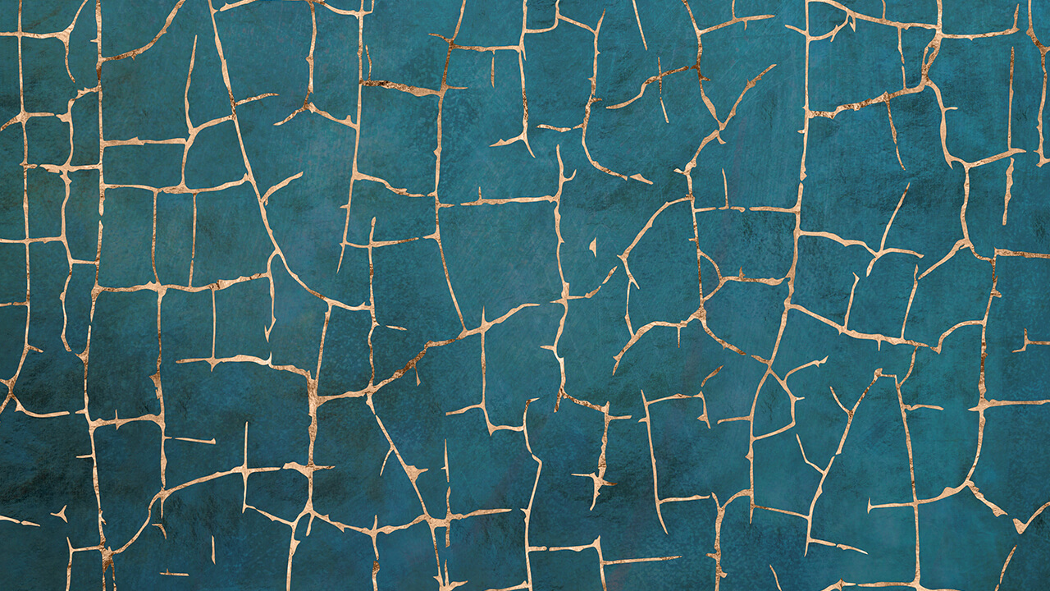
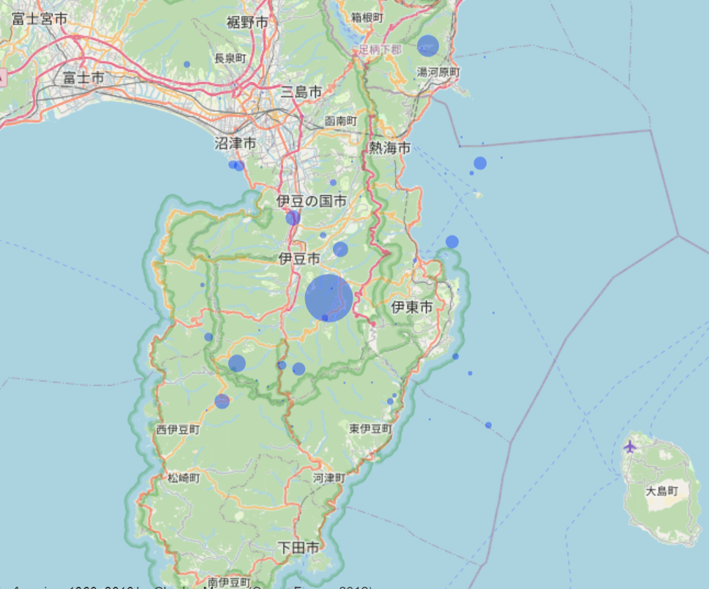
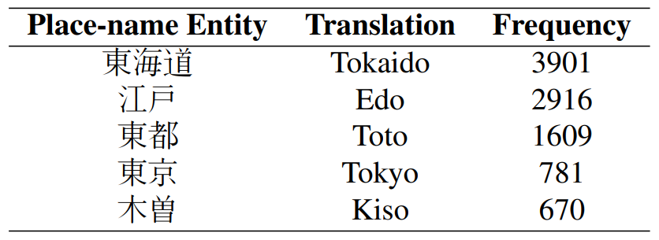
MAP APP
We used the best-performing fine-tuned BERT model in order to tag all the place-name entities mentioned within image content-related inscriptions printed on 20,408 prints. The place-names are pinned on a map. The size of each pin reflects the frequency of a given place-name.
Notes:
We used the best-performing fine-tuned BERT model in order to tag all the place-name entities mentioned within image content-related inscriptions printed on around 20,000 prints. The place-names are pinned on a map.
The size of each pin reflects the frequency of a given place-name. Moreover, we represent the five most frequent place-name that recognised by Bert with the Tokaido take the first place with around 4.000 appearance.

Slide 17



Limitations
• BERT NER model, fine-tuned on our dataset, can provide a means for ’distant viewing’. However, the model makes mistakes (e.g. places that belong outside Japan).
• Only a single place-name tag, PLACE, was used in BERT NER model.
• The dataset comprises only 200 instances, but more annotations can lead to more accurate models.
Future work
• Expand our dataset with more inscriptions, as well as with entity types.
• Undertake a spatiotemporal study of ukiyo-e landscape prints and investigate the benefits of NLP-fuelled ‘distant viewing’ by integrating the dimension of time in our analysis.
Conclusion
• Presented a dataset (is released for public use) of ukiyo-e landscape prints, with place-names included in the print inscriptions annotated by an art historian.
• Japanese BERT-based NER model can achieve a promising performance.
• Use-case of how can a distant viewing of a visual dataset be undertaken for facilitating research in art history.
Notes:
Limitation
Some limitations of our approach are the following:
- Although a BERT NER model, fine-tuned on our dataset, can provide a means for `distant viewing', as shown in the map, mistakes and noise is expected to be included in this view (e.g., places that belong outside Japan).
- Only a single place-name tag, PLACE, was used by our NER model because GPE and LOC were merged into a single entity type. However, a bigger dataset could allow analysis using a much more fine-grained resolution.
- Our released dataset comprises only 200 instances, but more annotations can lead to more accurate recognition.
Conclusion
For some takeaways, we presented a dataset of ukiyo-e landscape prints, with place-names in the inscriptions on the prints annotated by an art historian. This dataset is released for public use.
We showed that a Japanese BERT-based NER model can achieve a promising performance by unlocking useful applications.
We experimented with one such use case, regarding how can a distant viewing of such a visual dataset be undertaken with NER, as a step towards facilitating research in art history.
Future
Future work comprises the expansion of our dataset with more inscriptions, as well as with entity types.
Also, by integrating the dimension of time in our analysis, we will attempt to undertake a spatiotemporal study of ukiyo-e landscape prints and investigate the benefits of NLP-fuelled ‘distant viewing’.

Slide 18
Thank you!
Comments

Slide 19
Methodology
We used the best-performing fine-tuned BERT model in order to tag all the place-name entities mentioned within image content-related inscriptions printed on 20,408 prints. The place-names are pinned on a map. The size of each pin reflects the frequency of a given place-name.
Table: The five most frequent place-names recognised by BERT within the the 20,408 titles studied.

Slide 20

A Study of Distant Viewing of Ukiyo-e Prints
KONSTANTINA LIAGKOU, Athens University of Economics And Business
JOHN PAVLOPOULOS, Stockholm University
EWA MACHOTKA, Stockholm University
Notes:
Good morning and good afternoon!. My name is Ewa Machotka and I am Associate Professor specializing in Japanese Art History based at Stockholm University. I am here today together with Dr. John Pavlopoulos, a Computer Scientist, currently based at Ca’Foscari University of Venice and Konstantina Liagkou, a Data Scientist, currently post-graduate from Athens University of Economics and Business.
We would like present today the results of our collaborative research project called “A Study of Distant Viewing of Ukiyo-e prints”, which we started last spring together with Panos and Marita. But first of all, we would like to thank the International Joint Digital Archiving Center for Japanese Art and Culture, Ritsumeikan University for all their support throughout our project. Without it we would not be able to conduct this study and we hope that we’ll be able to extend this collaboration also in the future.

